Slide 1
ISO31000:2018 – RISK MANAGEMENT – AN INTRO
A Risk Practitioners Guide To ISO31000:2018
https://www.theirm.org/media/3513119/IRM-Report-ISO-31000-2018-v3.pdf

Slide 2
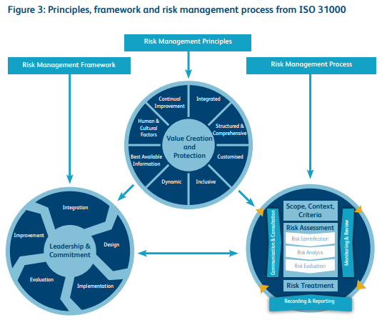
ISO31000:2018 – RISK MANAGEMENT – AN INTRO

Slide 3
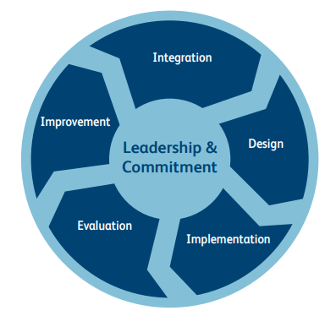
ISO31000:2018 – RISK MANAGEMENT – AN INTRO
Framework
5 components

Slide 4
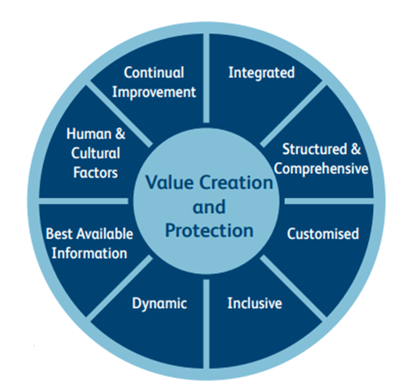
ISO31000:2018 – RISK MANAGEMENT – AN INTRO
8 PRINCIPLES

Slide 5
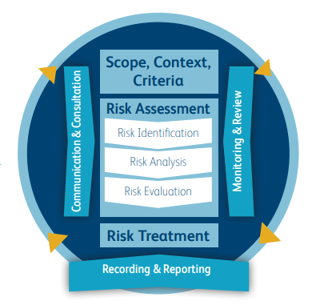
ISO31000:2018 – RISK MANAGEMENT – AN INTRO
RISK
MANAGEMENT
PROCESS

Slide 6
ISO31000:2018 – RISK MANAGEMENT – AN INTRO
ISO31000 objectives:
ISO 31000 states that the guidelines should be used by people who create and protect value in organisations by managing risks, making decisions, setting and achieving objectives and improving performance.
https://www.iso.org/obp/ui/#iso:std:iso:31000:ed-2:v1:en

Slide 7
ISO31000:2018 – RISK MANAGEMENT – AN INTRO
ISO31000 purpose:
ISO 31000 states that the purpose of risk management is the creation and protection of value.
END

